Slide 1

Identifying Unusual Points in Regression
Reading: 4.4
exercises: cH 4. 11abcd
Assigned: hw 5
Producer: dr. mario
img credit: alex riegert-waters

Slide 2


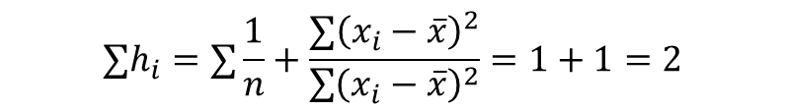

Leverage
“Potential” Impact on Linear Regression Fit
Formula:
Sum of Leverages:
Average Leverage or Typical Leverage:
Less Data or Farther from $\overline{x}$ = More Leverage
$$h_{i}=\frac{1}{n}+\frac{{\left(x_{i}−\overline{x}\right)}^{2}}{\sum{{\left(x_{i}−\overline{x}\right)}^{2}}}$$
$${∑h}_{i}=∑\frac{1}{n}+\frac{{∑\left(x_{i}−\overline{x}\right)}^{2}}{\sum{{\left(x_{i}−\overline{x}\right)}^{2}}}=1+1=2$$
$$\overline{h}=\frac{∑h_{i}}{n}=\frac{2}{n}$$

Slide 3
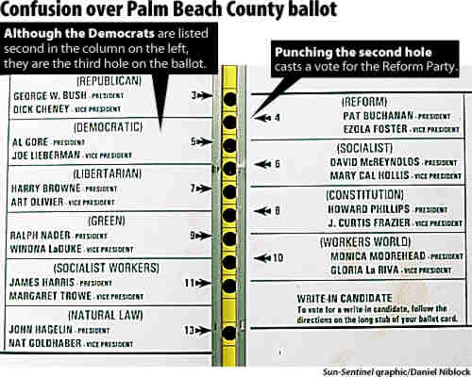
Example: Butterfly Ballots
2000 Election
Bush (Republican)
Gore (Democrat)
Buchanan (Third Party)
Unusual Results in Palm Beach
Nonstandard “Butterfly Ballot”
Accidental Voting?

Slide 4
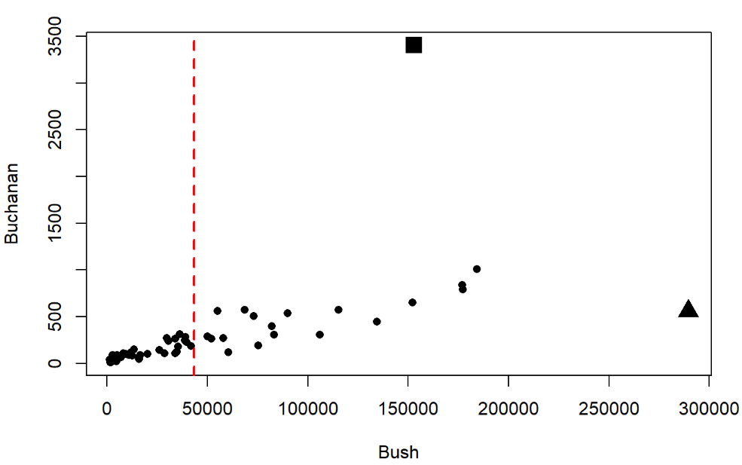
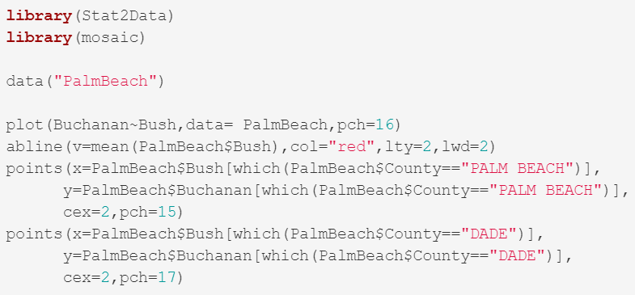
Example: Butterfly Ballots
Palm Beach
Dade

Slide 5
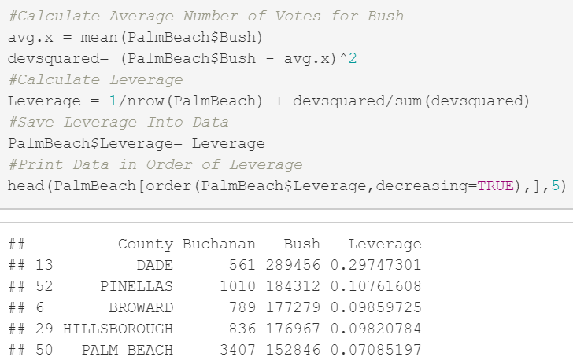

Example: Butterfly Ballots
Very Unusual Leverage
“Triple the Typical Leverage”
$$3∗\frac{2}{n}=3∗\frac{2}{67}=0.09$$

Slide 6

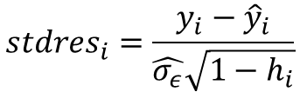
Standardized Residual
Old Formula:
New Formula:
Further Adjust for Leverage Since Some Points Impact More
Points with More Leverage Tend to Higher Standardized Residuals
$$stdres_{i}=\frac{y_{i}−{\hat{y}}_{i}}{\hat{σ_{ε}}}$$
$$stdres_{i}=\frac{y_{i}−{\hat{y}}_{i}}{\hat{σ_{ε}}\sqrt{1−h_{i}}}$$

Slide 7
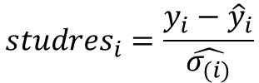
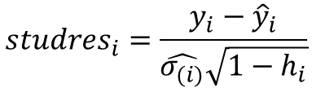
Studentized Residual
Old Formula:
New Formula:
We Calculate Standard Error of Regression After Removing Point
Line Doesn’t Change, Then Standardized Equals Studentized
$$studres_{i}=\frac{y_{i}−{\hat{y}}_{i}}{\hat{σ_{(i)}}}$$
$$studres_{i}=\frac{y_{i}−{\hat{y}}_{i}}{\hat{σ_{(i)}}\sqrt{1−h_{i}}}$$

Slide 8
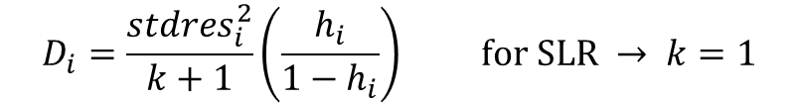
Cook’s Distance
Formula:
Amount of Influence Depends On:
Leverage
Distance from Line of “Best” Fit
Large Cook’s D Indicates Point Strongly Influences Regression
$$D_{i}=\frac{stdres_{i}^{2}}{k+1}\left(\frac{h_{i}}{1−h_{i}}\right) for SLR → k=1$$

Slide 9
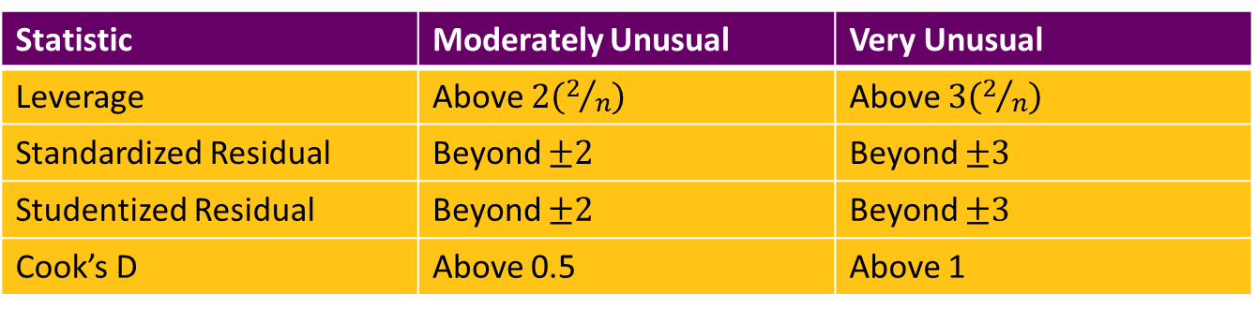
Rules of Thumb
We Can Calculate All Four Measures On Each Observation
Table Showing Accepted Definitions of
“Moderately Unusual”
“Very Unusual”
Statistic | Moderately Unusual | Very Unusual
Leverage | Above $2\left(2/n\right)$ | Above $3\left(2/n\right)$
Standardized Residual | Beyond $±2$ | Beyond $±3$
Studentized Residual | Beyond $±2$ | Beyond $±3$
Cook’s D | Above 0.5 | Above 1

Slide 10
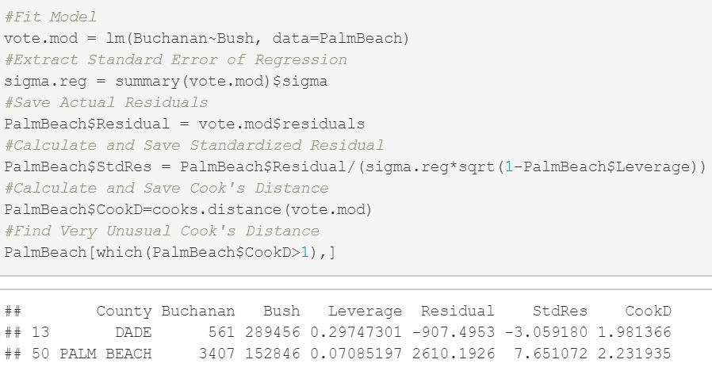
Example: Butterfly Ballots

Slide 11
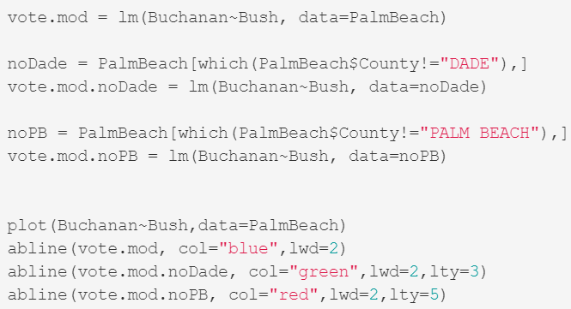
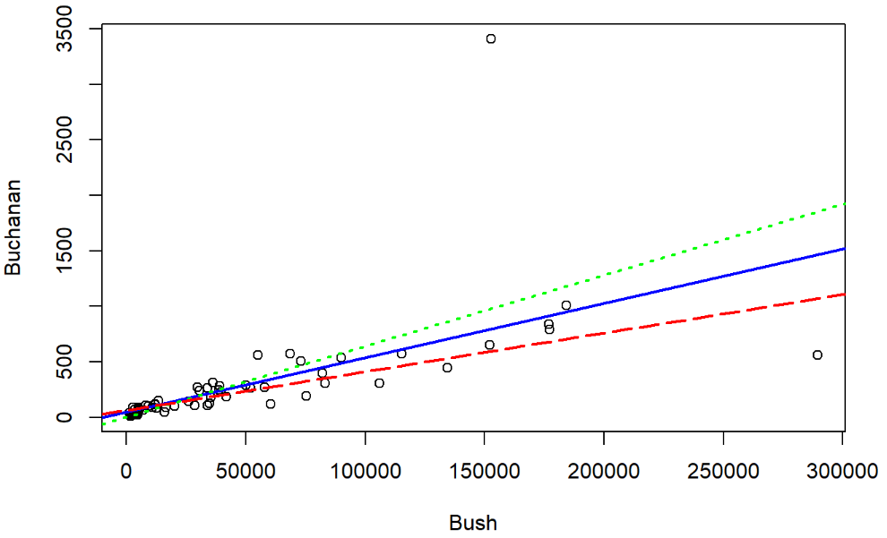
Example: Butterfly Ballots

Slide 12
Thank You
Make Reasonable Decisions

